Slide 1
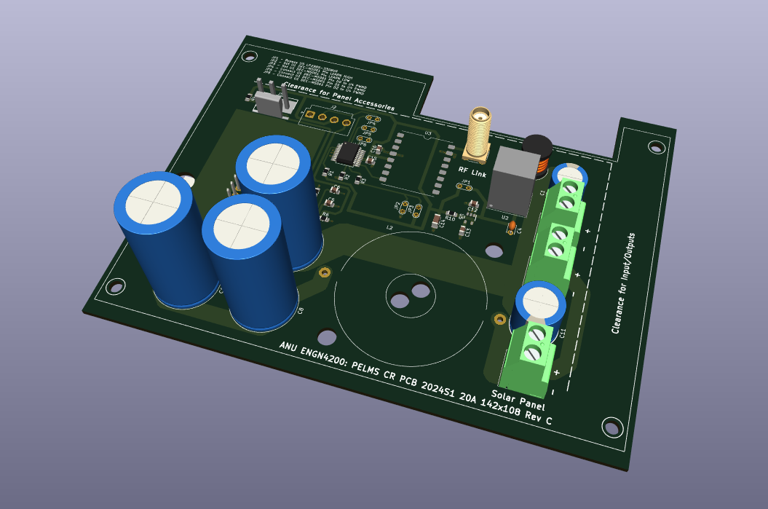
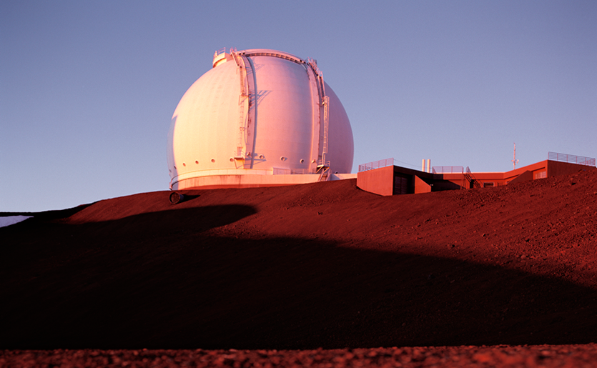
Development of a PORTABLE ELECTROLUMINSENCE MEASUREMENT SYSTEM – 2024S1
  ANU ENGN4200 Neil Bradbury u5841150
  Supervisor: Dr Marco Ernst
  Examiner: Mr. Anh Bui

Slide 2
Contents
01 | Design Project | 03
02 | Background | 06
03 | Methodology | 13
04 | Results | 35
05 | Conclusion | 44

Slide 3
Design
Project
  Overview
Overview
  The goal of my project was to continue the development work of a Portable Electroluminescence Measurement System (PELMS) that had previously been completed by the ENGN8170 Student project Team Solar in 2023.
  The Portable Electroluminescence Measurement System (PELMS) is a device that uses Electroluminescence (EL) imaging to identify defects in Photovoltaic (PV) modules. A unique modulation technique is used by the PELMS device to enhance the EL imaging system by removing external light noise.
  Team Solar had developed a PELMS device that implemented this modulation technique and was capable of imaging one PV module at a time to produce EL images.
  The team recommended five future area for work which became the basis for five deliverables of this project.

Slide 4
Design
Project
  Team Solar Recommendations
Team Solar Recommendations
    Improve image detail by increasing the images capture from 8-bit resolution to 12-bit resolution,
    Develop a more portable and reliable enclosure that houses components securely and prevents dust and water egress,
    Improve power management to optimise power consumption,
    Create a PCB board for the circuitry on the prototyping board, and
    Increase the current rating above 10A.

Slide 5
Design
Project
  PELMS 2024S1 Project Deliverables
PELMS 2024S1 Project Deliverables
    Develop python code to handle 12-bit resolution images and redevelop/update the GUI,
    Design and construct an improved enclosure,
    Modify electrical circuitry to optimise power,
    Construction of a PCB board for the electrical circuit to replace the prototyping board, and
    Recalculate the component values of the electric circuit to handle loads above 10A.

Slide 6
Background
  Electroluminescence(EL) Imaging and PV modules
Electroluminescence (EL) Imaging and PV modules
    Luminescence is where an object emits light only not heat,
    Conventionally, PV cells absorb light, and the PV cell induces a DC electrical current to flow,
    By reciprocity, the inverse phenomena is possible i.e. a DC electrical current injected into a PV cell will cause the PV cell to emit light
    The emitted light is in the infra-red (IR) range and not detectable by humans but is detectable by digital camera
    PV module is a configuration of PV cells – an EL image of PV module is one where a DC current has been injected into the PV module and the IR light is being emitted
    The industrial application of this phenomena is to identify failures and in a PV module and is discussed in Report IEA-PVPS T13-10:2018: Review on Infrared and Electroluminescence Imaging for PV Field Applications
Source: Report IEA-PVPS T13-10:2018, pp 45, Figure 2-27b

Slide 7
Background
  PELMS Modulation Technique
PELMS Modulation Technique
    EL images are combination of visible light and IR light
    A problem with EL imaging is that the image also captures the ambient visible light (which is regarded as noise) and the emitted IR light which contains the information about the PV module.
    Ideally, we remove or reduce the visible light component in the image and enhance the IR component
    The PELMS device was designed to use unique modulation technique to remove visible light from the EL image that would enhance the images
    The technique involves capturing a base image of the PV module containing only visible light (i.e. a normal image) followed by capturing an image of the PV module with a DC current injected into it that contains the visible light and the IR light
    The images are digital so the base image can be subtracted from the EL image which leaves behind the IR image which is what contains the information of the PV module

Slide 8
Background
  PELMS Modulation Technique
PELMS Modulation Technique
    The time domain implementation of this technique is shown below where the PELMS device will inject a DC current at arbitrary time intervals (i.e. 0 or 10 A) and the unit will send a trigger to the camera at the midpoint of the interval to capture a base image when the DC current is off (i.e. 0 A) and an EL image when the DC current is on (i.e. 10A)
    The PELMS device will then subtract, sum / stack /scale the differences of the images.
Source: Development of a Portable Electroluminescence Measurement System for Photovoltaic Modules, Leong et al, pp 1 Fig 1.

Slide 9
Background
  2023 Team Solar PELMS
2023 Team Solar PELMS
    Team Solar was the ENGN project team who built a PELMS device in 2023 that demonstrated the modulation technique.
    The developed system imaged one solar panel and produced electroluminescence images within 5 minutes.
    The developed system was built comprising of cheaper more readily available components such as Raspberry Pi and Raspberry Pi cameras.
Source: Development of a Portable Electroluminescence Measurement System for Photovoltaic Modules, Leong et al, pp 4 Fig 8.

Slide 10
Background
  2023 Team Solar PELMS Design
2023 Team Solar PELMS Design
    The device is composed of two subsystems:
        Electrical Circuit Subsystem
        Camera Algorithm Subsystem
Source: Development of a Portable Electroluminescence Measurement System for Photovoltaic Modules, Leong et al, pp 2 Fig 2.

Slide 11
Background
  2023 Team Solar PELMS Design
2023 Team Solar PELMS Design
      Camera Algorithm Subsystem components:
        Raspberry Pi is the Controller/Processor of the Camera Algorithm Subsystem – which runs a GUI and processing software that is written in Python.
        Raspberry Pi Display is implemented using a Smart Pi Touch 2 Touchscreen.
        IR Camera is implemented using a Raspberry Pi HQ Camera.
        RF Trigger is implemented a Linx Technologies 433 MHz Transmitter Evaluation Board.
Source: Development of a Portable Electroluminescence Measurement System for Photovoltaic Modules, Leong et al, pp 2, Fig 2 and pp 5, Fig 7.

Slide 12
Background
  2023 Team Solar PELMS Design
2023 Team Solar PELMS Design
      Electrical Circuit Subsystem components:
        Solar Module is the PV Module under test.
        Power Source is implemented using 52V E-bike battery.
        RF Trigger is implemented a Linx Technologies 433 MHz Transmitter Evaluation Board.
        Current Regulator is a circuit that injects a DC current into the Solar Panel when triggered via the RF Link.
Source: Development of a Portable Electroluminescence Measurement System for Photovoltaic Modules, Leong et al, pp 1 Fig 1.

Slide 13
Methodology
  Approach
Approach
    There were 5 deliverables for development work across the across the 2 subsystems of the 2023 PELMS device.
    The work for the 5 deliverables was broadly covered in 3 design fields of engineering:
        Software Development,
        PCB Design, and
        Electronic Enclosure Design.

Slide 14
Methodology
  Approach
Approach
    There were 5 recommendations across the 2 subsystems of the PELMS device
Recommendation | Deliverable | Relevant Subsystem | Relevant Design Field
Improve image detail by increasing the images capture from 8-bit resolution to 12-bit resolution | Develop python code to handle 12-bit resolution images and redevelop/update the GUI, | CAS | Software Development
Develop a more portable and reliable enclosure that houses components securely and prevents dust and water egress, | Design and construct an improved enclosure, | ECS | Enclosure Design
Improve power management to optimise power consumption, | Modify electrical circuitry to optimise power, | ECS | PCB Design
Create a PCB board for the circuitry on the prototyping board, and | Construction of a PCB board for the electrical circuit to replace the prototyping board, and | ECS | PCB Design
Increase the current rating above 10A. | Recalculate the component values of the electric circuit to handle loads above 10A. | ECS | PCB Design

Slide 15
Methodology
  Software Development
Software Development
    Recommendation: Improve image detail by increasing the images capture from 8-bit resolution to 12-bit resolution.
    Deliverable: Develop python code to handle 12-bit resolution images and redevelop/update the GUI.
    Background and Supporting Resources
      ENGN2219 Computing for Engineering
      ENGN4528 Computer Vision
      ENGN2218 Electronic Systems and Design
      Internet resource e.g., Stackoverflow, Python library pages etc.

Slide 16
Methodology
  Software Development
Software Development
    Python Libraries used:
      Tkinter for the GUI
      GPIO library for communicating with the RF Link
      Picamera2 for capturing images
      Opencv
      Numpy

Slide 17
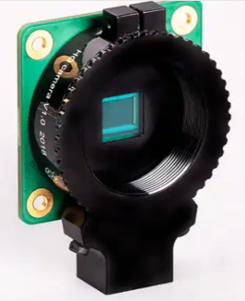
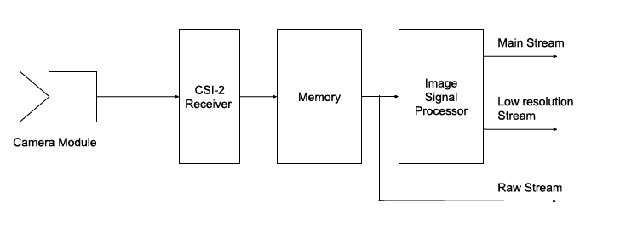
Methodology
  Software Development – Raspberry Pi Camera System
Software Development – Raspberry Pi Camera System
    Raspberry Pi HQ (High Quality) Camera
      Raw 12-bit, 12.3 MP, Sony IMX477 sensor
      Raw Capture Frame Size = 4056 x 3040 P = 12330240 P ≈ 12.3 MP
    Raspberry Pi camera system has 3 image stream outputs:
      main – quality – RGB or YUV format, typical 8-bit, configurable frame size
      lores – viable – YUV format, typical 8-bit, smaller frame than main image
      raw – original – Bayer image date, 12-bit, fixed frame size
Source: Raspberry Pi website: https://www.raspberrypi.com/products/raspberry-pi-high-quality-camera/. (15/05/2024)
Source: The Picamera2 Library, 2022-2023 Raspberry Pi Ltd, pp 15., Figure 2.

Slide 18
Methodology
  Software Development – Picamera2
Software Development – Picamera2
    Picamera2 is the software library that contains python software that communicates with the Raspberry Pi Camera.
    Differs to the original Picamera which was used in PELMS 2023
      Raspi-config legacy camera is ON for Picamera to work, OFF for Picamera2 to work
    Raspberry Picamera2 has 3 configuration modes which are:
      Still – capture that uses 4056 x 3040 raw frame for the a main, lores or raw image stream for still images
      Video – capture that uses 4056 x 3040 raw frame for the a main or lores image stream for video
      Preview – capture that uses 2028 x 1520 raw frame for the a main, lores or raw (still image only) image stream for still images or video

Slide 19
Methodology
  Software Development – Raw Image Processing Algorithm
Software Development - Raw Image Processing Algorithm
    Convert a raw 12-bit Bayer image format to 16-bit RGB format
    Python code:
      # Capture the VL image:
      # Get a raw Bayer frame with 12-bit values packed into 16-bits.
      # Convert Bayer 12-bit array to RGB 16-bit an write to file by
      # doing the following steps:
      # - Convert to 12-bit value to 16-bit by shifting 4 bits
      # - Convert from Bayer format to RGB format
      img_VL_Bayer_12bit = picam2.capture_array("raw").view(np.uint16)
      img_VL_Bayer_16bit = img_VL_Bayer_12bit * 16
      img_VL_RGB_16bit = cv2.cvtColor(img_VL_Bayer_16bit, cv2.COLOR_BAYER_RG2RGB)
Source: https://en.wikipedia.org/wiki/Bayer_filter#/media/File:Bayer_pattern_on_sensor.svg (15/05/2024)

Slide 20
Methodology
  PCB Design
PCB Design
    Recommendation: Improve power management to optimise power consumption
    Deliverable: Modify electrical circuitry to optimise power,
    Recommendation: Create a PCB board for the circuitry on the prototyping board
    Deliverable: Construction of a PCB board for the electrical circuit to replace the prototyping board, and
    Recommendation: Increase the current rating above 10A.
    Deliverable: Recalculate the component values of the electric circuit to handle loads above 10A.

Slide 21
Methodology
  PCB Design
PCB Design
    PCB Design is for the Current Regulator component of the Electrical Circuit Subsystem
    PCB Design decisions affect the Enclosure Design
    Background and Supporting Resources
      ENGN2218 Electronic Systems and Design
      ENGN4625 Power Systems
      Internet vendor websites and datasheets
    Professional Engineer Support Mr. Chris Jones
    Vendors
      Element14, Digikey, Jaycar

Slide 22
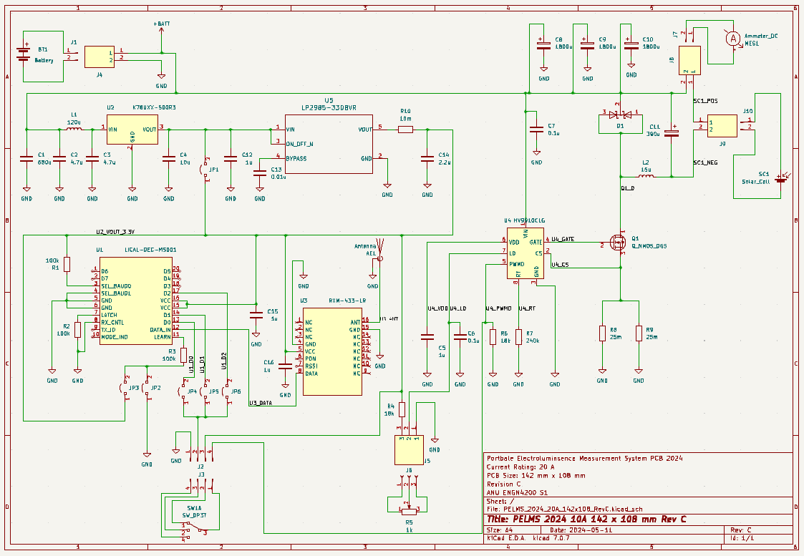
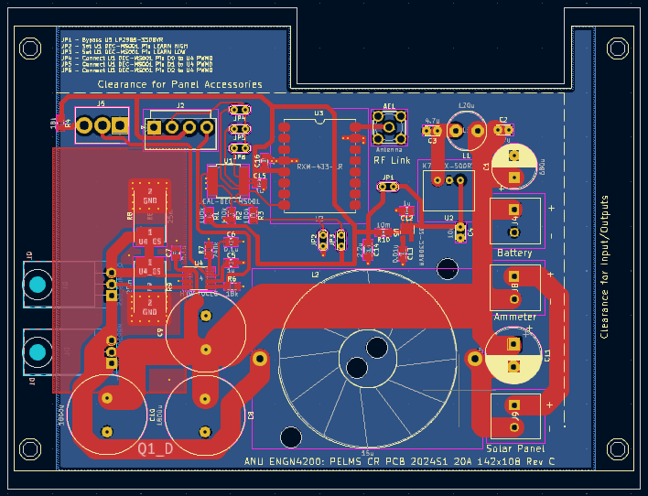
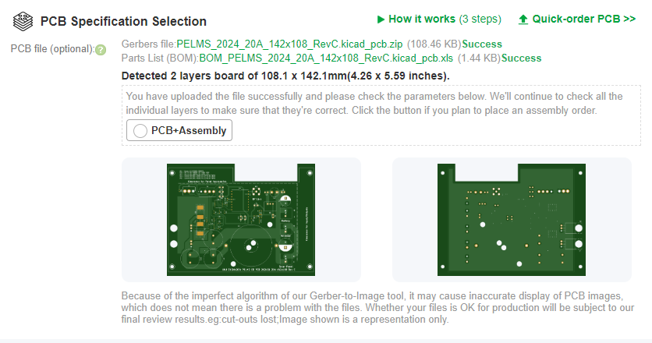
Methodology
  PCB Design – KiCad Development Process
PCB Design – KiCad Development Process
    KiCad is a free software suite for electronic design automation. It facilitates the design and simulation of electronic hardware for PCB manufacturing.
    Process is to edit a schematic, generate a PCB design from the schematic, generate Gerber files from the PCB design which can be passed on to a manufacturer.
    PCB Manufacturers: OSH Park (US), PCBWay (China), JLCPCB (China)

Slide 23
Methodology
  PCB Design – Create a PCB of Prototype
PCB Design – Create a PCB of Prototype
    Documentation of original prototype was circuit schematic using HV9910C chip.

Slide 24
Methodology
  PCB Design – Create a PCB of Prototype
PCB Design – Create a PCB of Prototype
    Generated a KiCad project: PELMS 2024 10A 142x110 Rev A
      Design was rated for the original 10 A.
      Confirmed component values and operation.
      Built on a reduced footprint 142 x 110 mm. This size was suitable for a reduced enclosure size of 170 mm x 120 mm rather than the original enclosure size of 240 mm x 160 mm.
      RF Link is implemented off-board and was connected connects via an optical coupler and was powered separately i.e., using 2 x 1.5V AA batteries.
      The track widths were modified thicker tracks were used for the heavier current loads while thinner tracks were used light current load i.e., those that were carrying signaling.
      Transistor Q1 and Diode D1 were placed underneath the board for to attach to an Aluminum plate that could draw heat away from the circuit.

Slide 25
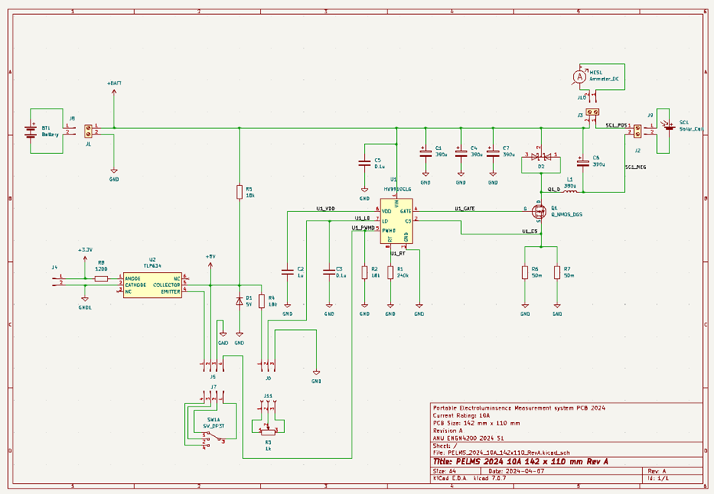
Methodology
  PCB Design – Create a PCB of Prototype
PCB Design – Create a PCB of Prototype
    PELMS 2024 10A 142x110 Rev A – Schematic

Slide 26
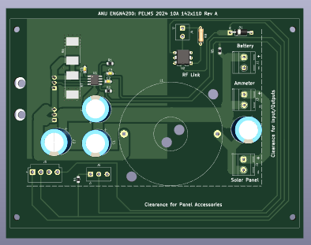
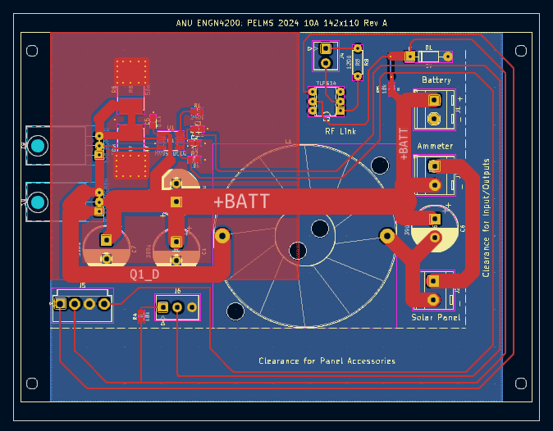
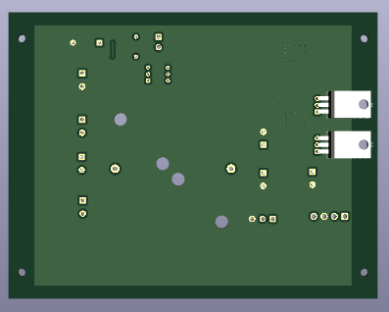
Methodology
  PCB Design – Create a PCB of Prototype
PCB Design – Create a PCB of Prototype
    PELMS 2024 10A 142x110 Rev A – PCB

Slide 27
Methodology
  PCB Design – Modification to on board RF Link and RF Link power
PCB Design – Modification to on board RF Link and RF Link power
    Generated a KiCad project: PELMS 2024 10A 142x110 Rev B
      Design was rated for the original 10 A.
      Built on a reduced footprint 142 x 110 mm.
      RF Link was on-boarded in this design. This required additional components including the DC/DC Converter (K78U03-500R3), RF Receiver (RXM-433-LR), decoder chip (LICAL-DEC-MS001) and Antenna mount.
      All components in the Current Regulator were now powered off the power source (i.e., the 52 V e-bike battery).
      There was significant increase in the signaling tracks.

Slide 28
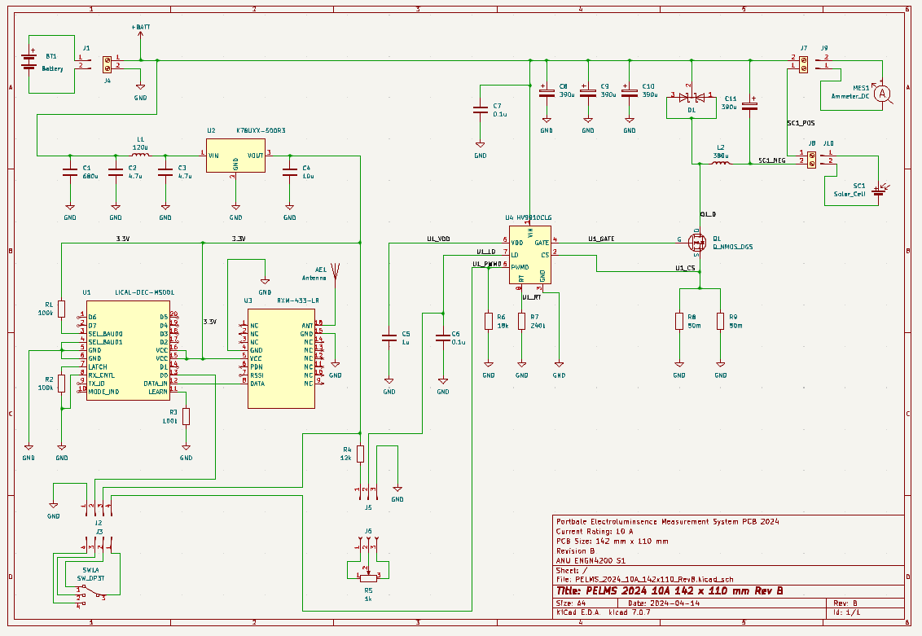
Methodology
  PCB Design – Modification to on board RF Link and RF Link power
PCB Design – Modification to on board RF Link and RF Link power
    PELMS 2024 10A 142x110 Rev B – Schematic

Slide 29
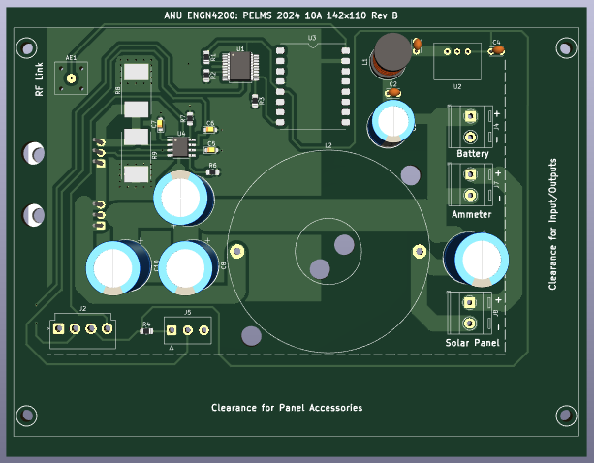
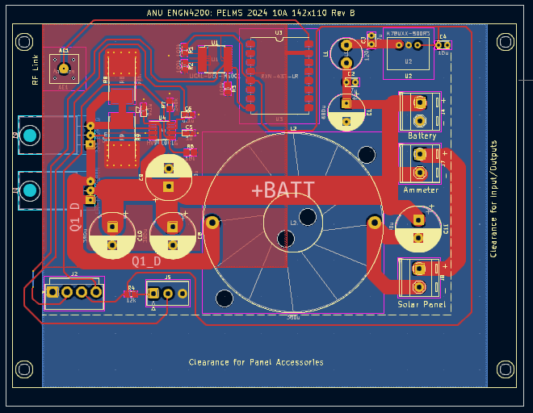
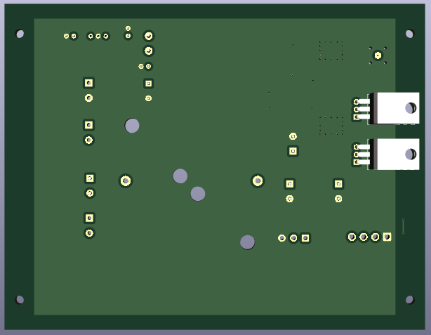
Methodology
  PCB Design – Modification to on board RF Link and RF Link power
PCB Design – Modification to on board RF Link and RF Link power
    PELMS 2024 10A 142x110 Rev B – PCB

Slide 30
Methodology
  PCB Design – Current rating upgrade to 20 A
PCB Design – Current rating upgrade to 20 A
    Generated a kiCAD project: PELMS 2024 10A 142x110 Rev C
      Design was upgraded to 20 A.
      Recalculation was needed for current sensing resistors, components and capacitors needed to be rated to handle 20A. This also included connectors and ingress/egress wiring.
      The footprint was slightly reduced 142 x 108 mm and some of the board was removed to clear potential space for a 20 A ammeter.
      RF Link was on-boarded in this design.
      All components in the Current Regulator were powered off the power source (i.e., the 52 V e-bike battery).
      Jumper options to switch on functionality on the chip.

Slide 31
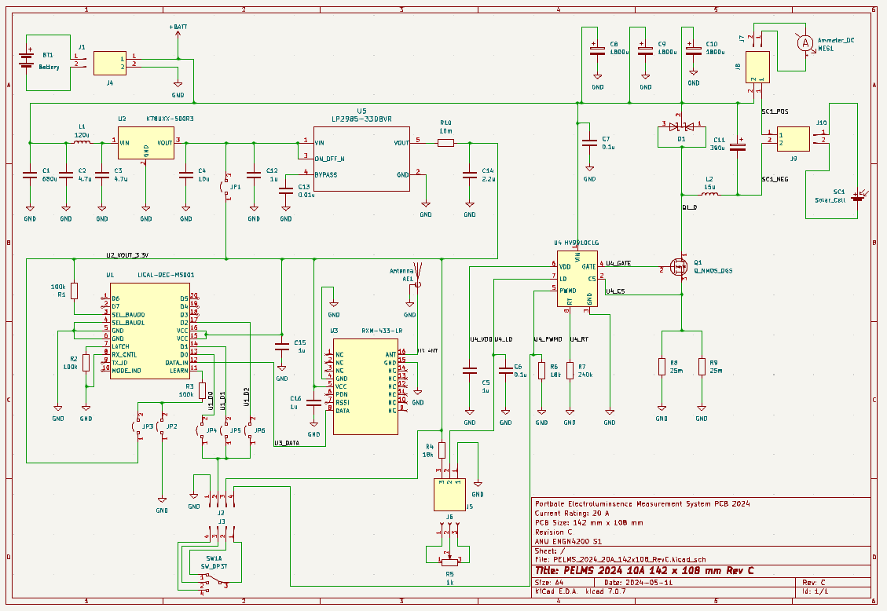
Methodology
  PCB Design – Current rating upgrade to 20 A
PCB Design – Current rating upgrade to 20 A
    PELMS 2024 20A 142x108 Rev C – Schematic

Slide 32
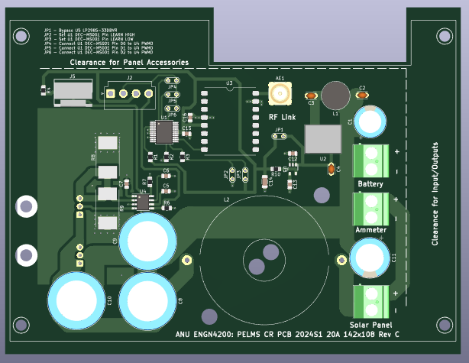

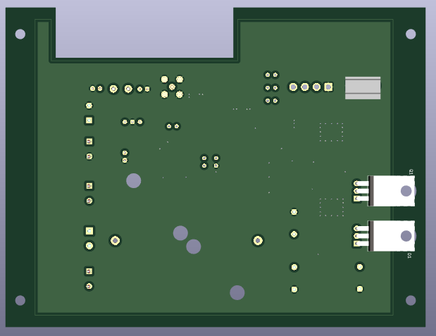
Methodology
  PCB Design – Current rating upgrade to 20 A
PCB Design – Current rating upgrade to 20 A
    PELMS 2024 10A 142x110 Rev C – PCB

Slide 33
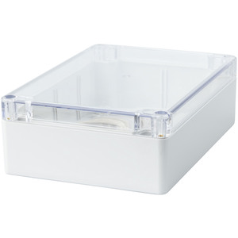
Methodology
  Enclosure Design
Enclosure Design
    Recommendation: Develop a more portable and reliable enclosure that houses components securely and prevents dust and water egress,
    Deliverable: Design and construct an improved enclosure,
    Background and Supporting Resources
      CIT ANUQ Electronics Workshop Practices
      Internet vendors and datasheets
    Enclosure Design was to house and reduce the footprint the Current Regulator component of the Electrical Circuit Subsystem.
    The enclosure that would house the Current Regulator was a Sealed Polycarbonate Enclosure 171 x 121 x 55 - Clear Lid
    Simplest but most costly in terms of trial and error i.e., circuits and software can be simulated but drilled holes may require a new enclosure purchase.
Source: https://www.jaycar.com.au/sealed-polycarbonate-enclosure-171-x-121-x-55-clear-lid/p/HB6248 (15/05/2024)

Slide 34
Methodology
  Enclosure Design
Enclosure Design
    Enclosure is rated to IP65.
    IP65 rating is ingress protection code
    First digit is solid particle protection:
      Value of 6 is Dust-tight – No ingress of dust; complete protection against contact (dust-tight).
    Second digit is liquid ingress protection:
      Value of 5 – Water jets; Water projected by a nozzle (6.3 mm (0.25 in)) against enclosure from any direction shall have no harmful effects.
    Approach is research, measure and fit subject to two design requirements for:
      Placement of PCB within the enclosure
      Placement of connections and peripherals to/from the enclosure

Slide 35
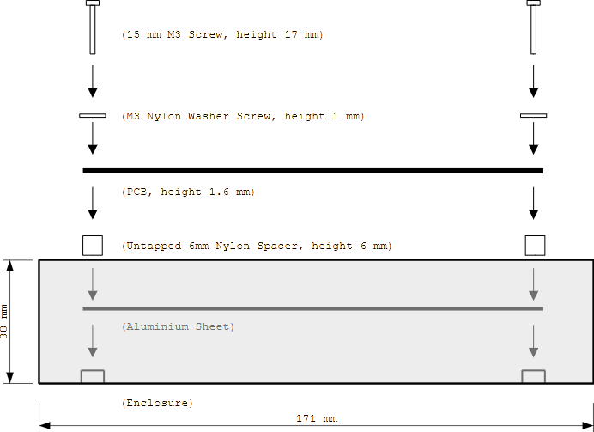
Results
  Enclosure Design – PCB Placement
Enclosure Design – PCB Placement
    PCB will sit on an Aluminum sheet as show in the side profile below.

Slide 36
Methodology
  Enclosure Design – Peripherals and Connections
Enclosure Design – Peripherals and Connections
    Design requirements are for placement of PCB
Connection/Peripheral | Designated Interface
Power Source Connection | 30 A Anderson PP connectors with housing (Connecting cable is 12 AWG – rated to 25 A)
Solar Panel Connectors | Cable Glands (Connecting cable is 12 AWG – rated to 25 A)
20A Ammeter | TBC - Space (Connecting cable is 12 AWG – rated to 25 A)
Current Level Controller | Potentiometer with knob
Current Regulator Mode | Switch with knob

Slide 37
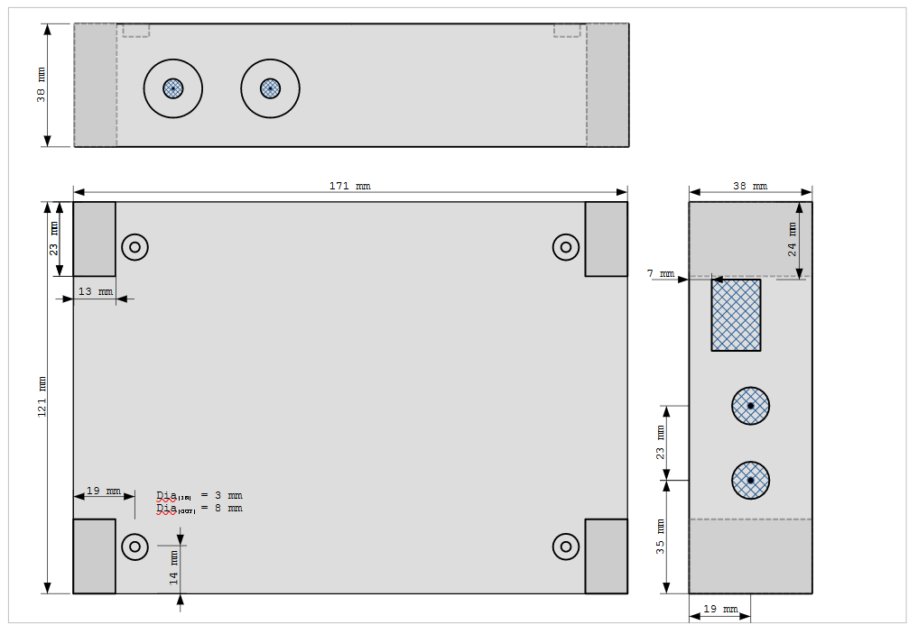
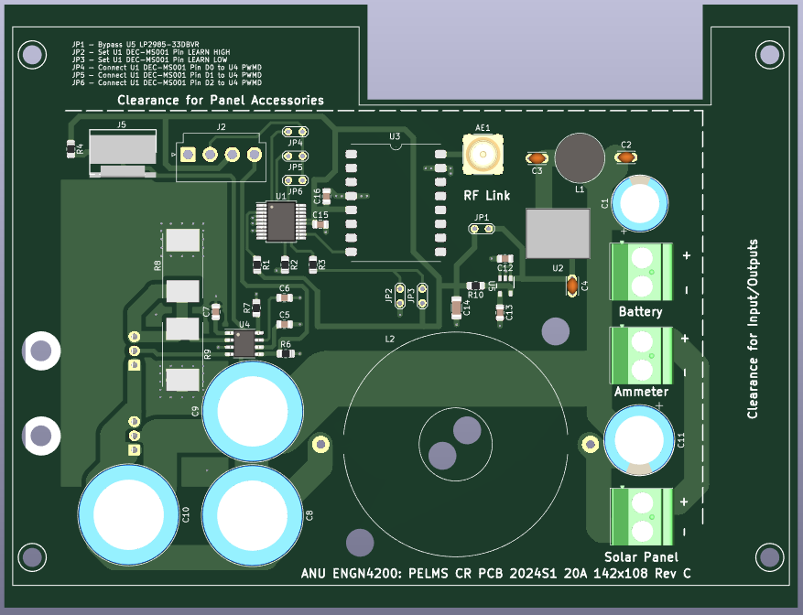
Methodology
  Enclosure Design – Peripherals and Connections
Enclosure Design – Peripherals and Connections
    Placement in the top-down profile.

Slide 38
Results
  Software Development
Software Development
    Achievements
      PELMS 2024S1 GUI has been developed
      Capable of capturing raw 12-bit images and creating gray and/or RGB files
      (Deliverable)
      Works with both 2023S1 and 2023S1 hardware i.e. because only connects to the RF Trigger
    Contribution to date
      12-bit resolution has produced images – but haven’t fully captured EL images

Slide 39
Results
  Software Development
Software Development
    Still to do
      Testing not completed
      Ideally compare images between PELMS2023 and PELMS2024
    Challenges
      Having some problems communicating with camera which is causing glitches. I haven’t diagnosed the problem – not sure if it is tkinter GUI or possibly some software/OS system updates based on light internet research.

Slide 40
Results
  PCB Design
PCB Design
    Achievements
      PCB Design completed (Deliverable)
      PCB Design rated to 20 A in the design (Deliverable)
      PCB RF Linx module has been on-boarded (Deliverable)
    Contribution to project
      Main contribution is the documentation of a Current Regulator PCB and the components
    Still to do
      PCB board is ordered, and the circuit needs to be built and tested.

Slide 41
Results
  PCB Design
PCB Design
    Challenges
      Most challenging of the 3 work areas
      As the complexity of the circuit increase so does changing a part
      Theory is not necessarily enough – there is a complex balance SWaP (Size , Weight and Power) that can start to affect costs
      Required the guidance of an experienced Engineer
      (Thanks Mr. Chris Jones)

Slide 42
Results
  Enclosure Design
Enclosure Design
    Achievements
      Enclosure footprint has been reduced.
      Initial Design made
    Contribution to project
      Documentation on cable egress or connecting to Power Source or Solar Panels
    Still to do
      Placement of a 20A Ammeter
      Tidy of documentation

Slide 43
Results
  Enclosure Design
Enclosure Design
    Challenges
      Changes depending on PCB design
      Incorrect hole placement

Slide 44
Conclusion
Conclusion
    Still have some outstanding work to complete.
    Great project to work on very well-rounded project.
      Software
      Hardware
      Electronics
      Computer Vision theory
    Lot of work – 200 Hours vs 2 Semester.
    Extension work
      Computer Vision a lot of detail
      Electronics – updating RF
      Software – lot of extra functionality

Slide 45
Thank you
  Supervisor: Dr Marco Ernst
  Examiner: Mr. Ahn Bui
  Engineer: Mr. Chris Jones
  Neil Bradbury
  ANU ENGN4200
  E-mail: u5841150@anu.edu.au

